Slide 1
Credit Card Approval Detection
CAPSTONE PROJECT
Presented By:
AMBIKA AJAI SINGH
NSTI(National Skill Training Institute) Prayagraj.
ADIT (Advanced Diploma in IT Networking & Cloud Computing).
STU64634a7e071eb1684228734

Slide 2
OUTLINE
Problem Statement
Proposed System/Solution
System Development Approach
Algorithm & Deployment
Result
Conclusion
Future Scope
References

Slide 3
Problem Statement
Credit card companies must have the ability to detect fraudulent transactions in order to identify unauthorized purchases that are not made by the customers. As a result, many financial institutions have implemented stringent measures for credit card usage. Data science and Machine Learning now play a crucial role in assisting financial institutions by providing advanced and robust models that help administrators identify fraudulent transactions associated with users’ credit cards.

Slide 4
Proposed Solution
The proposed system aims to tackle the challenge of predicting Credit Card Approval Detection. This involves using Data Analytics and Machine Learning techniques to identify patterns accurately. The solution will consist of the following components :
Data Collection:
Gather data with relevant columns which had a huge impact on the credit card approval estimation like, profession, current_house_years, house_owner, car_owner and income.
The dataset is a .csv file splitted into train and test dataset. The train training dataset consists of around more than 2 lakh data entries of individuals from around the country.
Data Preprocessing:
Clean and preprocess the collected data to handle missing values, outliers, and inconsistencies.
Machine Learning Algorithm:
Implement a machine learning algorithm , such as K Nearest Neighbour and Decision Tree, to make predictions based on historical patterns.
Deployment:
Develop a user-friendly interface or application that provides predictions.
Deploy the solution on a freely available and reliable platform, like GitHub.
Evaluation:
Assess the model's performance using appropriate metrics such as Mean Absolute Error (MAE), Root Mean Squared Error (RMSE), or other relevant metrics.
Result:
The result will be a robust Credit Card Approval System capable of providing accurate and timely forecasts, aiding in environmental decision-making and public awareness regarding credit card fraud and approval conditions.

Slide 5
System Approach
System requirements:
Hardware Requirements:
A computer/server with sufficient processing power to handle data processing and model training.
High-speed internet connection for data retrieval and updates.
Software Requirements:
Operating System: Linux-based systems are widely preferred and used for Data Science and Machine Learning tasks.
Programming Language: Python is a popular language for building Machine Learning models.
Library required to build the model
Data Processing and Analysis:
NumPy: For numerical operations and handling large arrays of data.
Pandas: For data manipulation and analysis.
Matplotlib and Seaborn: For data visualization.
Machine Learning Libraries:
Scikit-learn: It is a simple and efficient machine learning library for data analysis and modeling in Python, providing a wide range of tools for classification, regression, clustering, and more.

Slide 6
Algorithm & Deployment
Algorithm Selection:
Chosen Algorithm: K Nearest Neighbour, and Decision Tree a robust ensemble model suitable for predicting continuous variables related to the model, providing resilience against overfitting and accommodating diverse features.
Data Input:
Features include historically important factors (e.g., current_house_years, house_owner, car_owner and income), forming a comprehensive input for the Decision Tree model to capture patterns.
Training Process:
The K Nearest Neighbour and Decision Tree is trained on historical financial data, with the dataset split into training and validation sets. Cross-validation is applied, and hyperparameter tuning is conducted to optimize the model's performance.
Prediction Process:
For predicting the future values, the trained Decision Tree Model uses the data inputs, adapting to the environmental conditions and providing accurate, ensemble-based predictions.

Slide 7
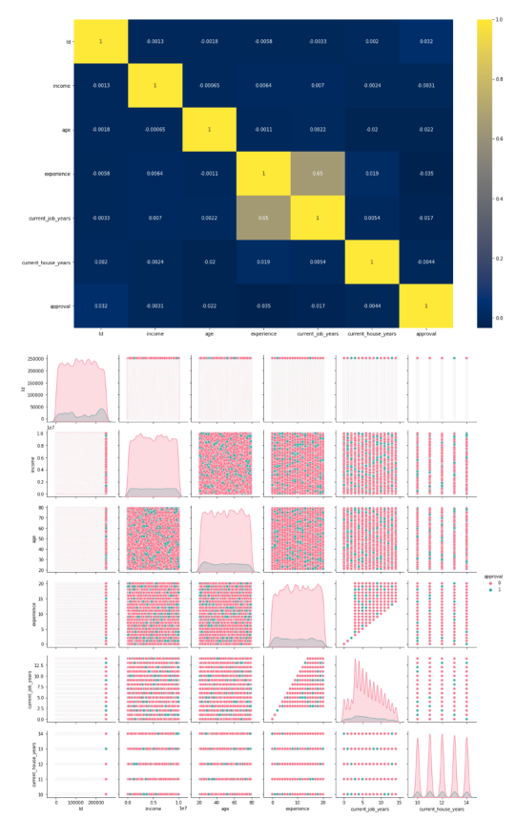
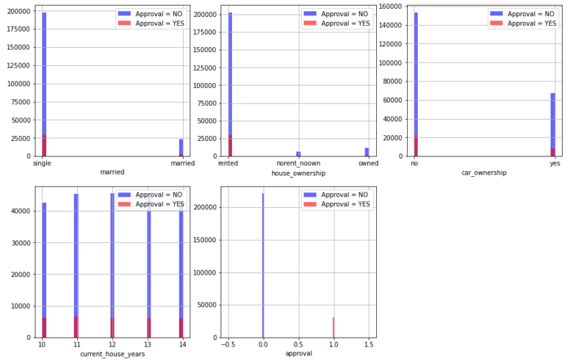
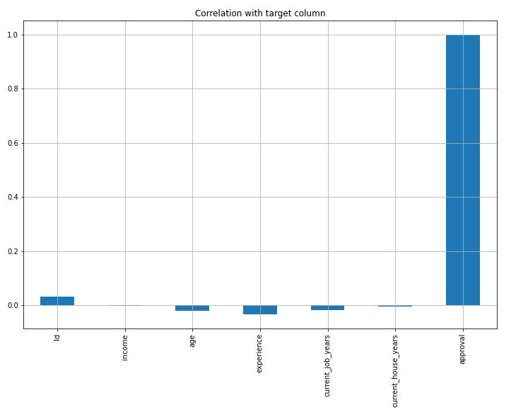
Result
This analysis could also provide insights into the most affected factors related to the project.
Deployment Link of my Project:
https://github.com/amazing-ambika/Credit-Card-Approval-Prediction-System

Slide 8
Conclusion
The development of an Credit Card Approval Prediction System is imperative in addressing the critical issue of fraudulent and unauthorized purchases and its impact on public and the finances. Through the systematic integration of machine learning algorithms, comprehensive data analysis, and effective communication strategies, the system aims to provide accurate and timely predictions.

Slide 9
Future scope
The future scope of the Credit Card Approval System involves enhancing model accuracy through continuous data refinement, integrating advanced sensor technologies for real-time inputs, and extending the system to a broader geographic scale for comprehensive environmental monitoring.

Slide 10
References
Dataset Source: Kaggle hosts a vast repository of datasets across various domains, providing a platform for data scientists and analysts to access, explore, and use data for their projects.
The dataset has already been uploaded in GitHub along with project.
Website: https://www.kaggle.com/
Machine Learning libraries: NumPy, Pandas, Matplotlib, Seaborn
Machine Learning Models: Decision Tree, Random Forest , Support Vector Machine, Linear Regression, KNN etc.

Slide 11
THANK YOU

